Slide 1

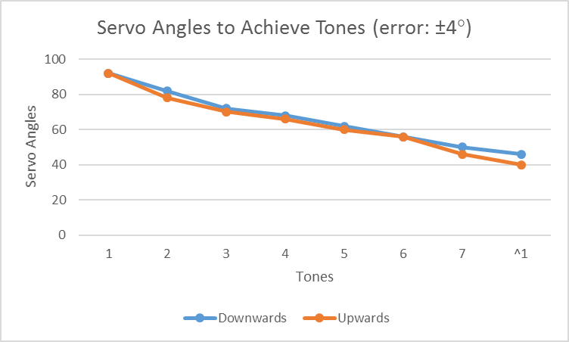
Band Scooby Project (Ruler Player)
Yichen Wu | Prof. Mehta | UCLA
Objectives
Materials
Results
Automate music playing with a steel ruler.
Collaborate with other band members.
Be configurable over WiFi.
Materials | Quantity
Node ESP8266-12E board | 1
ESP12 motor shield | 1
Steel ruler | 1
L-shape Wood base | 1
Servo (9g, 3.3V) | 2
Toothpicks | 4
Light sensor | 1
Project Overview
This project uses two servos to play music. One plucks a steel ruler, and the other adjust the length of ruler being plucked to control tone.
It has a light sensor so that other robots can start/pause it with LED light signals.
It also broadcasts a WiFi and can be configured by its HTTP clients.
Procedure
Step 1
Fix the continuous servo as the plucker.
Step 2
Make a slot for the steel ruler to slide in.
Step 3
Hot glue the other servo to the box.
Step 4
Make a linkage.
Note: Tuning results differ for two moving directions.
Techniques Used
Possible Improvements
Interrupt structure:
A soft system timer that allows to system to play music in real time.
The interval 260ms is chosen such that the continuous servo pick plucks once in a single interval and that the regular servo can move to proper position in two interval times.
WiFi communication:
Other than the light signal control, it can also be controlled by WiFi clients as a standalone instrument.
Just with a touch of a button on the client side, it can enter/exit the light-sensor control mode.
Handcrafting cannot make perfect mechanical parts. Crafting with 3D printing or in a good workshop will make it better.
Step 5
Drill a dent.
Step 6
Make a pick with toothpicks.
Step 7
Add light sensor.
Related Websites
Ruler Player site:
http://github.com/popo0293/ee183d-lab2
http://github.com/popo0293/ee183d-lab3
Band site:
http://github.com/viktorzhang.github.io

